Slide 1

The Secretary problem
Group E
Dorna Jahangoshay
Javier Rodriguez
Wonder Mahembe
Hamza Anwar
Mehrose Tanveer

Slide 2

Agenda
Purpose
Setting
Strategies overview
Results

Slide 3
Purpose
To hire a “good enough” candidate
To minimise search time

Slide 4
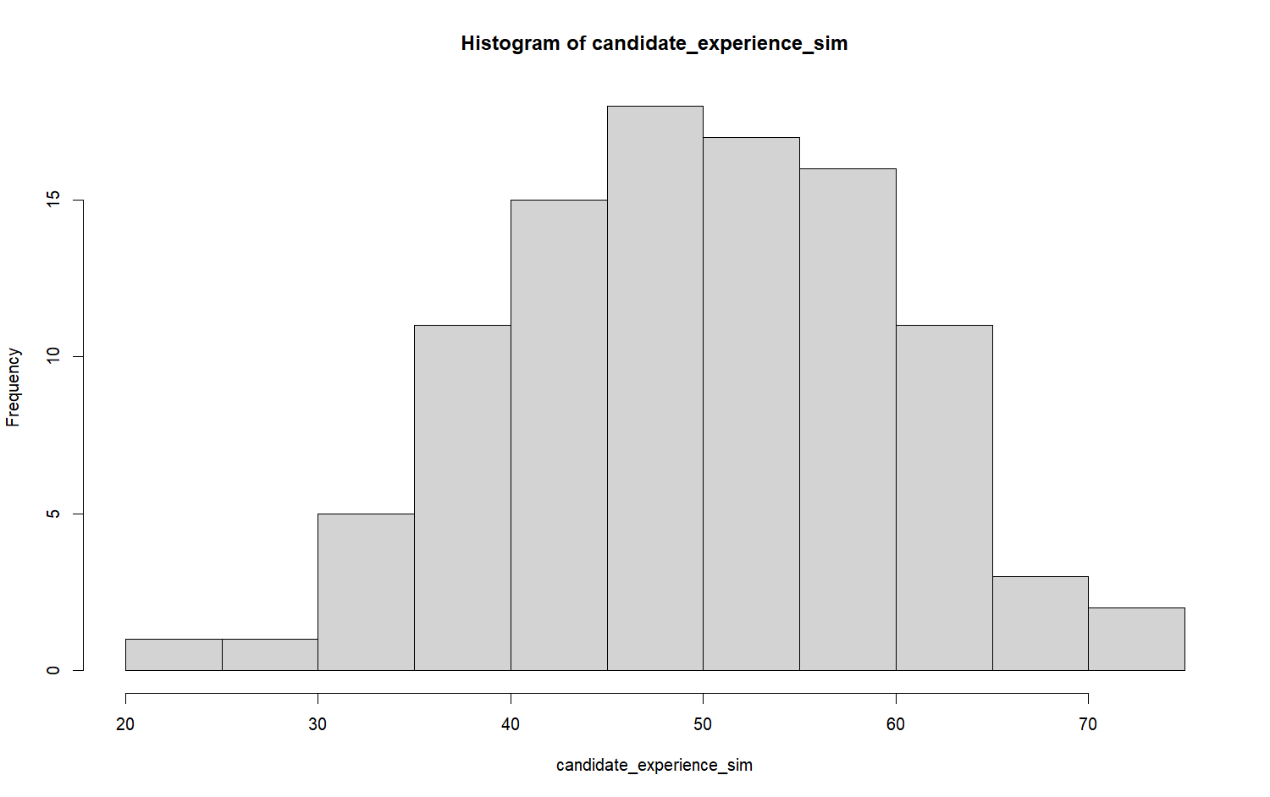
Universal setting
100 candidates > arriving randomly > one each day
Experience is measurable, in points
There is only one best candidate (75 pts)
Experience distribution = N(50, 10)
Simulation ran 10 000 times

Slide 5
Strategies explored
Strategies
The optimal strategy (baseline)
Modified optimal
Fixed threshold
Dynamic threshold
Comparison Metrics
Mean experience level of hired candidate
Number of interviews until hire
Probability of selecting the best/ number of times the best candidate was hired

Slide 6
Baseline ~ the optimal strategy
Uses the first 37% for ‘looking’, and 63% for ‘leaping’
Always seeks to hire the best candidate
Sim1: [64, 14, 39, 70, 45, 50, 19, 35, 58, 38, 44, 48, 66, 60, 69, 57, 44, 30, 65, 62]
Sim2: [60, 65, 64, 44, 57, 39, 62, 50, 58, 14, 35, 66, 48, 44, 69, 70, 30, 38, 19, 45]
Sim3: [38, 39, 30, 57, 62, 65, 66, 50, 48, 44, 64, 14, 69, 60, 44, 70, 58, 45, 19, 35]
Sim4: [14, 44, 57, 58, 45, 64, 19, 65, 69, 48, 60, 70, 44, 50, 30, 66, 35, 62, 39, 38]
Sim5: [64, 50, 60, 19, 70, 45, 58, 62, 48, 65, 14, 30, 39, 38, 35, 44, 44, 57, 69, 66]
Sim6: [70, 45, 14, 69, 58, 65, 50, 39, 48, 62, 60, 44, 64, 30, 35, 66, 44, 38, 19, 57]
Sim7: [66, 44, 60, 50, 58, 44, 62, 35, 19, 48, 70, 38, 39, 64, 65, 30, 69, 45, 57, 14]
Sim8: [62, 58, 70, 64, 65, 50, 69, 44, 57, 30, 45, 14, 60, 38, 48, 19, 35, 44, 66, 39]
Sim9: [14, 45, 65, 35, 44, 64, 60, 44, 66, 30, 70, 69, 58, 19, 48, 39, 62, 57, 38, 50]
Sim10: [57, 69, 66, 14, 50, 44, 45, 39, 70, 60, 65, 44, 30, 19, 48, 38, 62, 58, 64, 35]
**
**

Slide 7
Modified Optimal Strategy
Uses the 37% rule for ‘looking’, and 63% for ‘leaping’
However, from the 38th person, we calculate and set a 95% threshold based on explored data. We then hire whoever meets the threshold
Sim1: [64, 14, 39, 70, 45, 50, 19, 35, 58, 38, 44, 48, 66, 60, 69, 57, 44, 30, 65, 62]
Sim2: [60, 65, 64, 44, 57, 39, 62, 50, 58, 14, 35, 66, 48, 44, 69, 70, 30, 38, 19, 45]
Sim3: [38, 39, 30, 57, 62, 65, 66, 50, 48, 44, 64, 14, 69, 60, 44, 70, 58, 45, 19, 35]
Sim4: [14, 44, 57, 58, 45, 64, 19, 65, 69, 48, 60, 70, 44, 50, 30, 66, 35, 62, 39, 38]
Sim5: [64, 50, 60, 19, 70, 45, 58, 62, 48, 65, 14, 30, 39, 38, 35, 44, 44, 57, 69, 66]
Sim6: [70, 45, 14, 69, 58, 65, 50, 39, 48, 62, 60, 44, 64, 30, 35, 66, 44, 38, 19, 57]
Sim7: [66, 44, 60, 50, 58, 44, 62, 35, 19, 48, 70, 38, 39, 64, 65, 30, 69, 45, 57, 14]
Sim8: [62, 58, 70, 64, 65, 50, 69, 44, 57, 30, 45, 14, 60, 38, 48, 19, 35, 44, 66, 39]
Sim9: [14, 45, 65, 35, 44, 64, 60, 44, 66, 30, 70, 69, 58, 19, 48, 39, 62, 57, 38, 50]
Sim10: [57, 69, 66, 14, 50, 44, 45, 39, 70, 60, 65, 44, 30, 19, 48, 38, 62, 58, 64, 35]
**
**

Slide 8
Fixed Threshold Strategy
Assumes that we have some knowledge of the distribution of candidates’ experience.
We set a 95% experience threshold and hire the first person who meets it.
Sim1: [64, 14, 39, 70, 45, 50, 19, 35, 58, 38, 44, 48, 66, 60, 69, 57, 44, 30, 65, 62]
Sim2: [60, 65, 64, 44, 57, 39, 62, 50, 58, 14, 35, 66, 48, 44, 69, 70, 30, 38, 19, 45]
Sim3: [38, 39, 30, 57, 62, 65, 66, 50, 48, 44, 64, 14, 69, 60, 44, 70, 58, 45, 19, 35]
Sim4: [14, 44, 57, 58, 45, 64, 19, 65, 69, 48, 60, 70, 44, 50, 30, 66, 35, 62, 39, 38]
Sim5: [64, 50, 60, 19, 70, 45, 58, 62, 48, 65, 14, 30, 39, 38, 35, 44, 44, 57, 69, 66]
Sim6: [70, 45, 14, 69, 58, 65, 50, 39, 48, 62, 60, 44, 64, 30, 35, 66, 44, 38, 19, 57]
Sim7: [66, 44, 60, 50, 58, 44, 62, 35, 19, 48, 70, 38, 39, 64, 65, 30, 69, 45, 57, 14]
Sim8: [62, 58, 70, 64, 65, 50, 69, 44, 57, 30, 45, 14, 60, 38, 48, 19, 35, 44, 66, 39]
Sim9: [14, 45, 65, 35, 44, 64, 60, 44, 66, 30, 70, 69, 58, 19, 48, 39, 62, 57, 38, 50]
Sim10: [57, 69, 66, 14, 50, 44, 45, 39, 70, 60, 65, 44, 30, 19, 48, 38, 62, 58, 64, 35]
**
**
**
**
**
**

Slide 9
Dynamic Threshold Strategy
The desired threshold changes depending on our level of desperation.
Threshold falls as the remaining pool of candidates lessens.
Number of remaining candidates | Experience threshold
75 candidates | 99%
50 candidates | 85%
25 candidates | 70%
< 25 candidates | 50%

Slide 10
Results

Slide 11
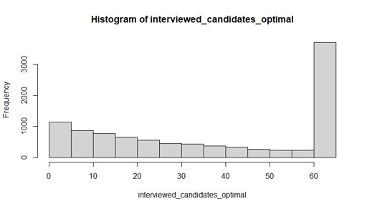
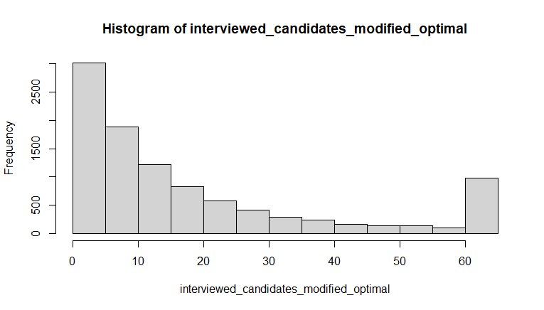
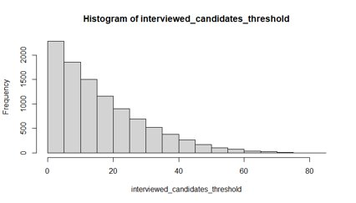
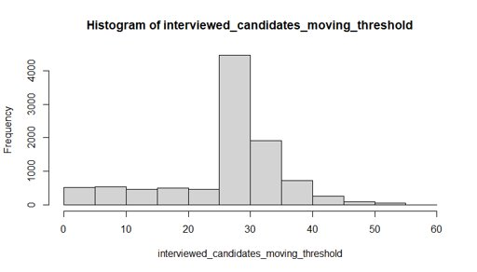
Notes:
Q2: Is the search time affected?

Slide 12
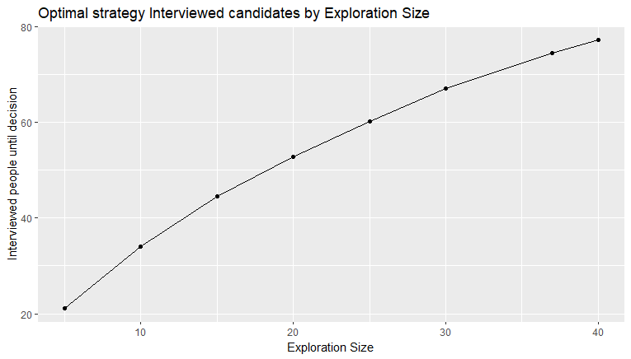
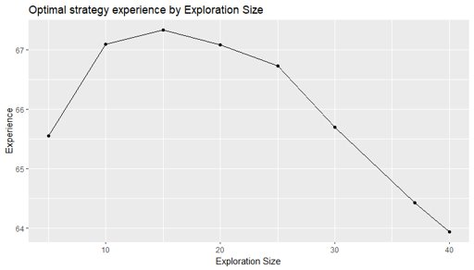
Notes:
Q1: Is there scope for revising the exploration strategy in the good-enough setting?
Q2: Is the search time affected?
Q3: How much worse is the selected candidate compared to the best candidate?

Slide 13
Strategy | % exploring data | Experience | Difference with best candidate (%) | Nº of interviews until hiring | % probability of hiring the best candidate
Different exploration sizes | 40 | 63.93 | 21.29 | 77.22 | 37.12
 | 37 | 64.42 | 20.35 | 74.39 | 37.24
 | 30 | 65.69 | 17.90 | 67.12 | 37.15
 | 25 | 66.72 | 15.92 | 60.13 | 36.76
 | 20 | 67.08 | 15.23 | 52.77 | 34.08
 | 15 | 67.33 | 14.75 | 44.58 | 30.24
 | 10 | 67.09 | 15.21 | 34.00 | 24.03
 | 5 | 65.54 | 18.19 | 21.09 | 16.00
Modified Optimal | 100/e | 67.12 | 15.15 | 54.93 | 18.12
Fixed Threshold (95%) | - | 69.40 | 10.77 | 16.78 | 20.03
Dynamic Threshold | - | 67.57 | 14.29 | 26.40 | 31.39
Best = 75
Notes:
Q1: Is there scope for revising the exploration strategy in the good-enough setting? - Yes -> 10% data for exploration
Q2: Is the search time affected? - Yes
Q3: How much worse is the selected candidate compared to the best candidate? - 8%

Slide 14

Thank you!

